Slide 1
Big Mountain’s Big Picture
By Luis Vallesteros

Slide 2
The Issue at hand
To accommodate the rising operating costs, can Big Mountain Resort increase its ticket premium by up to 10% while also factoring in cutting costs by certain facilities?
We have addressed your ideas and narrowed down to the following options:
Permanently closing down up to 10 of the least used runs. This doesn't impact any other resort statistics.
Increase the vertical drop by adding a run to a point 150 feet lower down but requiring the installation of an additional chair lift to bring skiers back up, without additional snow making coverage
Same as number 2, but adding 2 acres of snow making cover
Increase the longest run by 0.2 mile to boast 3.5 miles length, requiring an additional snow making coverage of 4 acres

Slide 3
Solution:
Cut lowest performing run
AND
Add a new run with a vertical drop of 150 feet

Slide 4
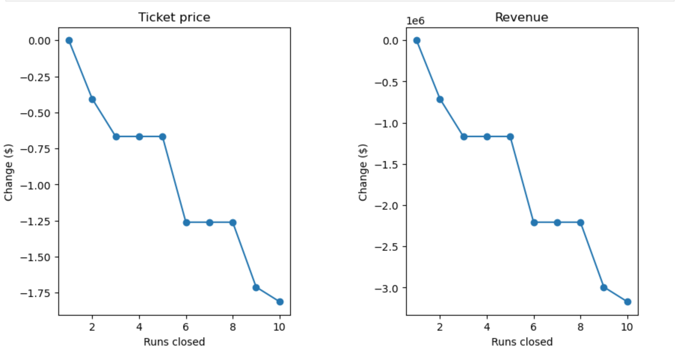
Why drop the lowest performing run?
Our random forest model applied to the dataset you provided indicates that removing one run from the resort will not affect long term ticket prices and overall revenue. Any more than one, however, can dramatically affect the resort’s revenue.

Slide 5
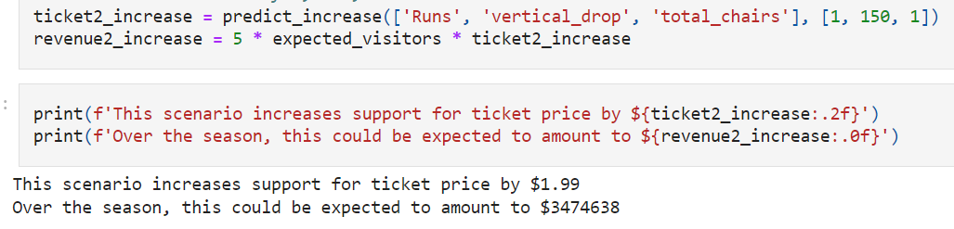
Why add a new 150 vertical drop run?
This will encourage a $1.99 ticket price increase in addition to a $3,474,638 spike in revenue, should you also choose to add an additional chair lift to the resort.
Increasing the snow and increasing the longest run with the new chair lift, however, will not affect the revenue.

Slide 6
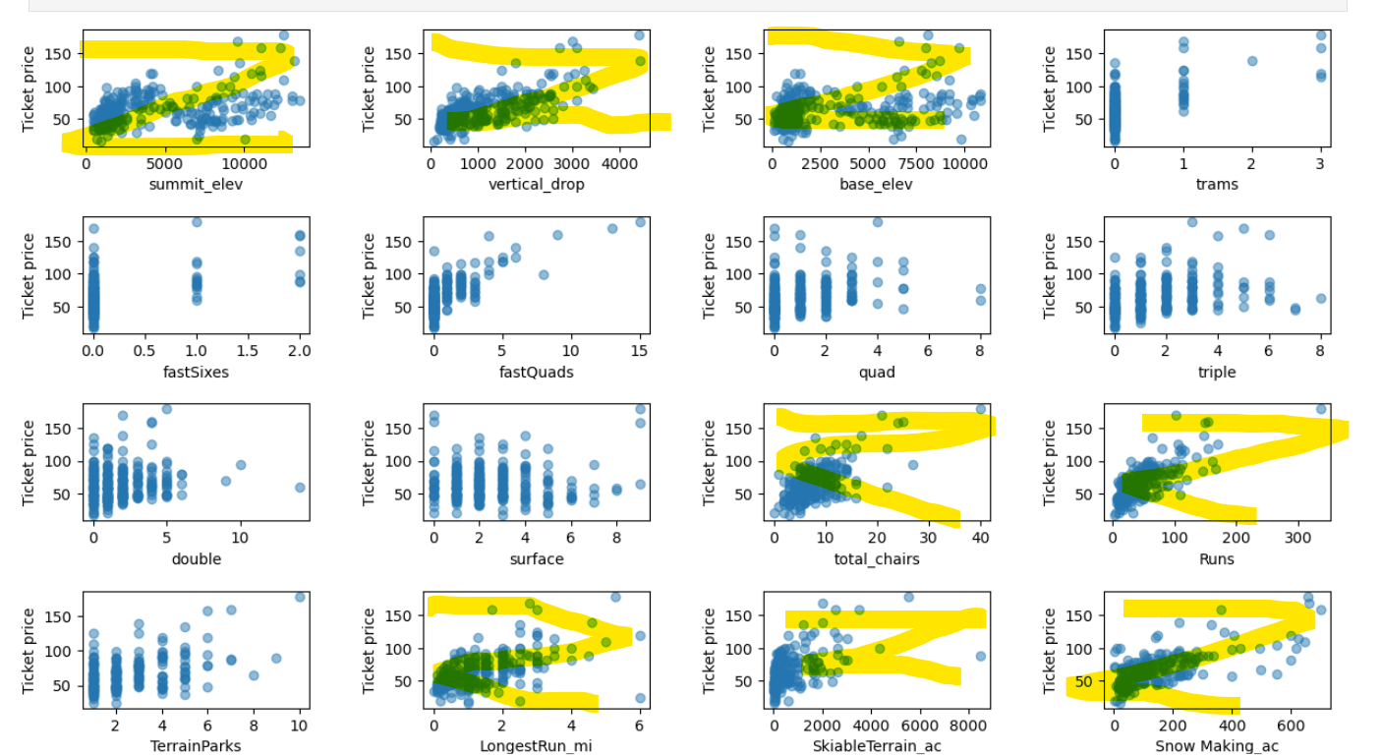
From the dataset you sent
Our linear regression model the strongest determining coefficients of Big Mountain’s popularity and higher price tag for tickets:
Vertical Drop
Snow Making
# of Chairs
# of Runs
Longest Run
Trams
Skiable Terrain

Slide 7
Conclusion
Big Mountain, despite being a pricier resort than both national and Montana averages, may be justified in raising its ticket price based on its superior offerings. Compared to the average resort, Big Mountain boasts higher elevation, more snow-making capabilities, more chairs and fast quads, and more skiable terrain. While closing a run likely won't impact revenue, adding a new run with a 150-foot vertical drop holds promise for a significant rise in both ticket price and revenue. Overall, further exploration of both scenarios 1 and 2 (close the least performing run and adding a 150 run) is recommended, with cost analysis being a crucial next step.

